Slide 1
OOP
Omnia Hosny

Slide 2
Agenda
Topic 1: What is OOP?
Topic 2: Main Concepts of (OOPs)
Topic 3: Explain Main Concepts
Topic 4: Solution min project

Slide 3
Topic one
What is OOP?

Slide 4


Introduction
In Python, object-oriented Programming (OOPs) is a programming paradigm that uses objects and classes in programming. It aims to implement real-world entities like inheritance, polymorphisms, encapsulation, etc. in the programming. The main concept of OOPs is to bind the data and the functions that work on that together as a single unit so that no other part of the code can access this data.

Slide 5
Topic two
Main Concepts of Object-Oriented Programming (OOPs)

Slide 6
Main Concepts of Object-Oriented Programming (OOPs)
Class
Objects
Polymorphism
Encapsulation
Inheritance
Data Abstraction

Slide 7
Class
A class is a collection of objects. A class contains the prototype from which the objects are being created. It is a logical entity that contains some attributes and methods.
Some points on Python class:
Classes are created by keyword class.
Attributes are the variables that belong to a class.
Attributes are always public and can be accessed using the dot (.) operator. Eg.: Myclass.Myattribute

Slide 8
Object
The object is an entity that has a state and behavior associated with it.
An object consists of :
State: It is represented by the attributes of an object. It also reflects the properties of an object.
Behavior: It is represented by the methods of an object. It also reflects the response of an object to other objects.
Identity: It gives a unique name to an object and enables one object to interact with other objects.

Slide 9
Inheritance
Inheritance is the capability of one class to derive or inherit the properties from another class.
The benefits of inheritance are:
It represents real-world relationships well.
It provides the reusability of a code. We don’t have to write the same code again and again. Also, it allows us to add more features to a class without modifying it.
It is transitive in nature, which means that if class B inherits from another class A, then all the subclasses of B would automatically inherit from class A.

Slide 10
Polymorphism
Polymorphism simply means having many forms.

Slide 11
Encapsulation
This puts restrictions on accessing variables and methods directly and can prevent the accidental modification of data. To prevent accidental change, an object’s variable can only be changed by an object’s method. Those types of variables are known as private variables.
A class is an example of encapsulation as it encapsulates all the data that is member functions, variables, etc.

Slide 12
Constructor
Types of constructors :
default constructor: The default constructor is a simple constructor which doesn’t accept any arguments. Its definition has only one argument which is a reference to the instance being constructed.
parameterized constructor: constructor with parameters is known as parameterized constructor. The parameterized constructor takes its first argument as a reference to the instance being constructed known as self and the rest of the arguments are provided by the programmer.

Slide 13
Constructor
Types of constructors :
default constructor: The default constructor is a simple constructor which doesn’t accept any arguments. Its definition has only one argument which is a reference to the instance being constructed.
parameterized constructor: constructor with parameters is known as parameterized constructor. The parameterized constructor takes its first argument as a reference to the instance being constructed known as self and the rest of the arguments are provided by the programmer.

Slide 14
Destructors
Destructors are called when an object gets destroyed. In Python, destructors are not needed as much as in C++ because Python has a garbage collector that handles memory management automatically.
The __del__() method is a known as a destructor method in Python. It is called when all references to the object have been deleted i.e when an object is garbage collected.

Slide 15
Decorator
What is Class Method in Python?
The @classmethod decorator is a built-in function decorator that is an expression that gets evaluated after your function is defined. The result of that evaluation shadows your function definition. A class method receives the class as an implicit first argument, just like an instance method receives the instance

Slide 16
Decorator
What is the Static Method in Python?
A static method does not receive an implicit first argument. A static method is also a method that is bound to the class and not the object of the class. This method can’t access or modify the class state. It is present in a class because it makes sense for the method to be present in class.

Slide 17
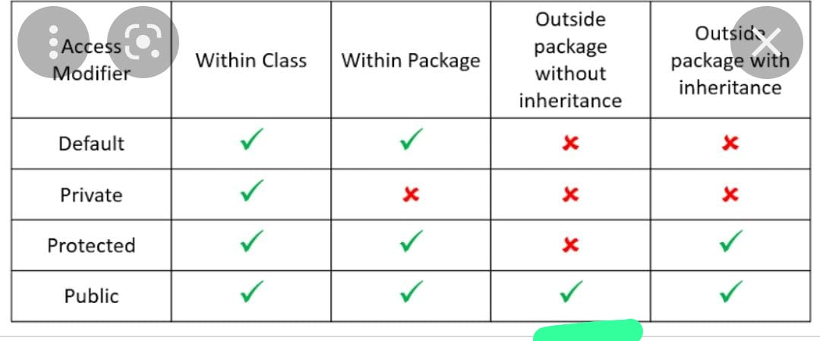

Slide 18

The way to get started is to quit talking and begin doing.
Walt Disney

Slide 19
Thank you

